Slide 1
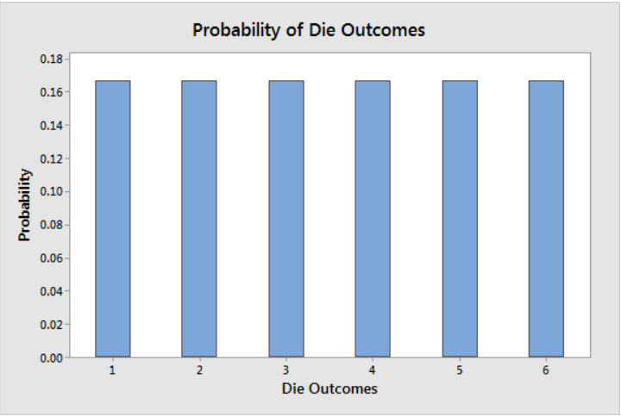
A uniform distribution is a continuous random variable in which all values between a minimum value and a maximum value have the same probability. The probability density function is the constant function f(x)=1/(b‐a), which creates a rectangular shape.
Graphing Distributions and Finding Probabilities
Graphing is a great way to see what uniform distributions look like and find probabilities. Below, I’ll graph discrete and continuous forms of the distribution.
For discrete uniform distributions, finding the probability for each outcome is 1/n, where n is the number of outcomes. Rolling dice has six outcomes that are uniformly distributed. Therefore, each one has a likelihood of 1/6 = 0.167. The bar chart below displays the rectangular-shaped distribution.

Slide 2
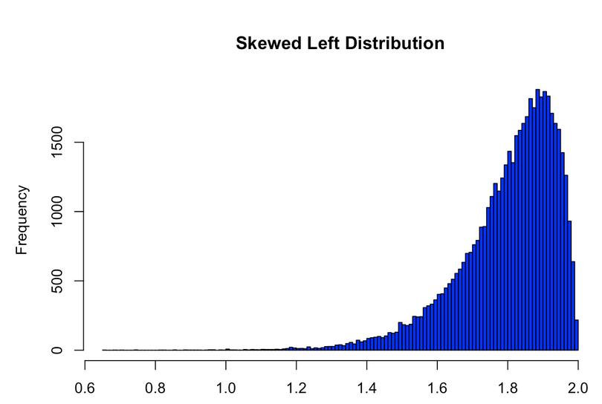
A left-skewed distribution is longer on the left side of its peak than on its right. In other words, a left-skewed distribution has a long tail on its left side. Left skew is also referred to as negative skew. [epoch example]

Slide 3
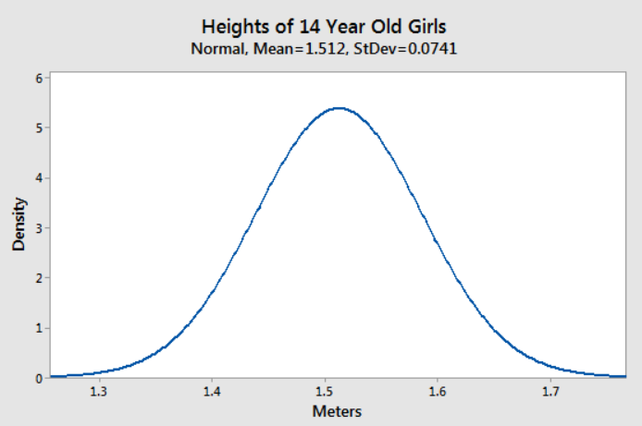
Normal distribution, also known as the Gaussian distribution, is a probability distribution that is symmetric about the mean, showing that data near the mean are more frequent in occurrence than data far from the mean. The normal distribution appears as a "bell curve" when graphed.

Slide 4
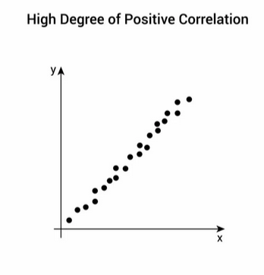
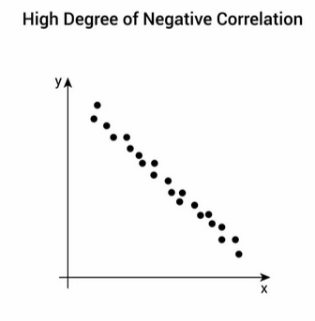
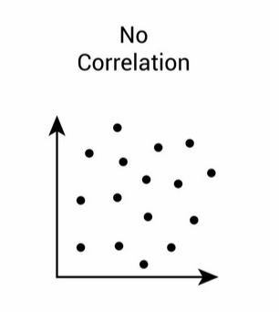
Positive correlation refers to a relationship between two variables where they both increase or decrease together. It is represented by a correlation coefficient ranging from 0 to +1, indicating a strong positive relationship between the variables.

Slide 5
The linear correlation coefficient is a number calculated from given data that measures the strength of the linear relationship between two variables: x and y. The sign of the linear correlation coefficient indicates the direction of the linear relationship between x and y.
Non-linear correlation is defined as when the ratio of variations between two given variables changes. Example- with the 20% increase in the income the expenditure sometimes increase by 5% sometimes by 10% or by 15%. Hence, it is non-linear correlation.

Slide 6
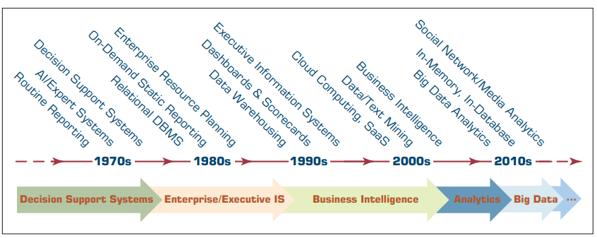
Evolution of Decision Support, Business Intelligence, and Analytics

Slide 7
In the 2010s, we are seeing yet another paradigm shift in the way that data is captured and used. Largely because of the widespread use of the Internet, new data generation mediums have emerged.
Of all the new data sources (e.g., radio-frequency identification [RFID] tags, digital energy meters, clickstream Web logs, smart home devices, wearable health monitoring equipment), perhaps the most interesting and challenging is social networking/social media.
This unstructured data is rich in information content, but analysis of such data sources poses significant challenges to computational systems, from both software and hardware perspectives.
Recently, the term Big Data has been coined to highlight the challenges that these new data streams have brought on us. Many advancements in both hardware (e.g., massively parallel processing with very large computational memory and highly parallel multiprocessor computing systems) and software/algorithms (e.g., Hadoop with MapReduce and NoSQL) have been developed to address the challenges of Big Data.

Slide 8
Assignment-01
List three of the terms that have been predecessors of analytics.
What was the primary difference between the systems called MIS, DSS, and Executive Support Systems?
Did DSS evolve into BI or vice versa?

Slide 9
Business intelligence (BI) is an umbrella term that combines architectures, tools, databases, analytical tools, applications, and methodologies. It is, like DSS, a content-free expression, so it means different things to different people. Part of the confusion about BI lies in the flurry of acronyms and buzzwords that are associated with it (e.g., business performance management [BPM]).
BI’s major objective is to enable interactive access (sometimes in real time) to data, to enable manipulation of data, and to give business managers and analysts the ability to conduct appropriate analyses.
By analyzing historical and current data, situations, and performances, decision makers get valuable insights that enable them to make more informed and better decisions.
The process of BI is based on the transformation of data to information, then to decisions, and finally to actions.

Slide 10
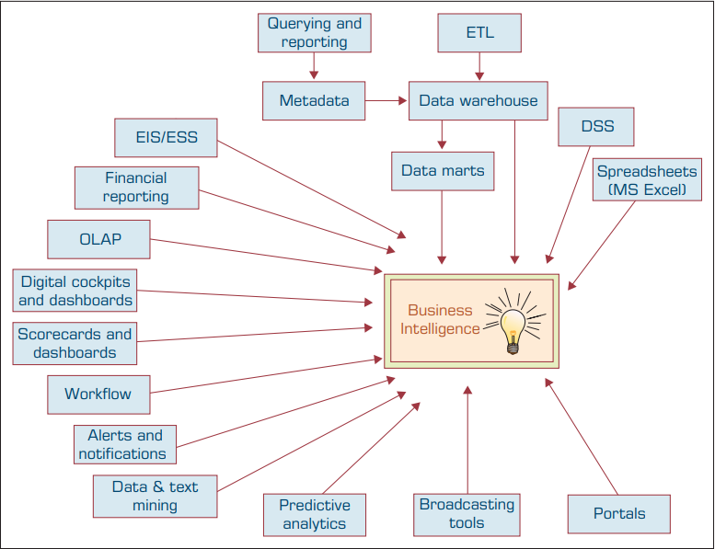
Evolution of Business Intelligence (BI)

Slide 11
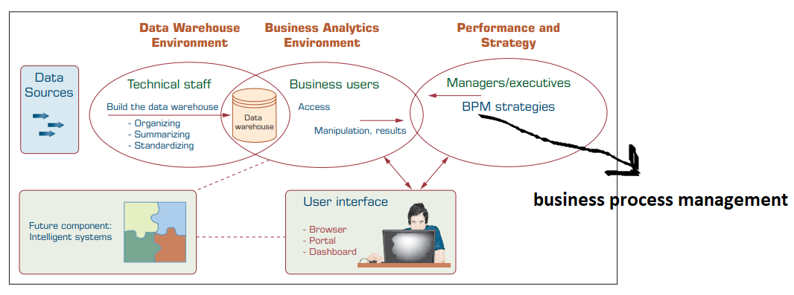
The Architecture of BI

Slide 12
Short Notes on:
OLAP
OLTP
SCM/CRM
Case Study. (Chapter 1)
1.1, 1.2, 1.3, 1.4, and 1.5
Self study:
Is it a good idea to follow a hierarchy of descriptive and predictive analytics before applying prescriptive analytics?
2. How can analytics aid in objective decision making?

Slide 13
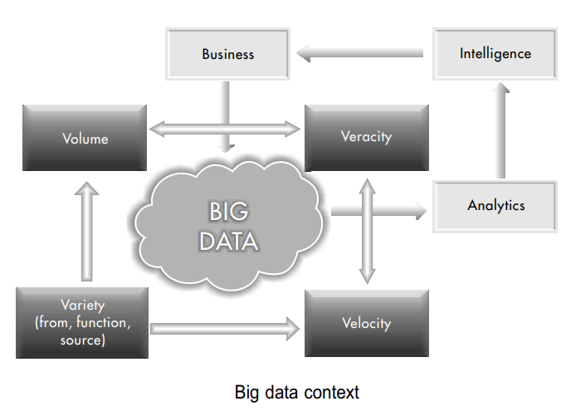
Big Data is an all-inclusive term that refers to extremely large, very fast, highly diverse, and complex data that cannot be managed with traditional data management tools.

Slide 14
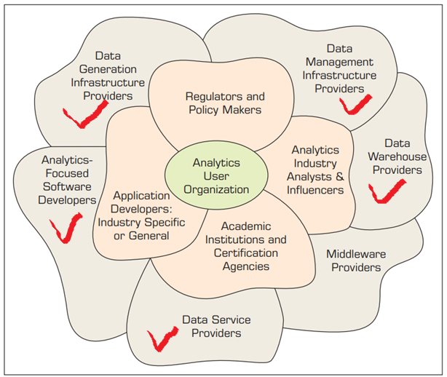
An Overview of the Analytics Ecosystem

Slide 15
